Slide 1

PageRank Algorithm
Dr. Mohammad Rezwanul Huq
Associate Professor
East West University

Slide 2
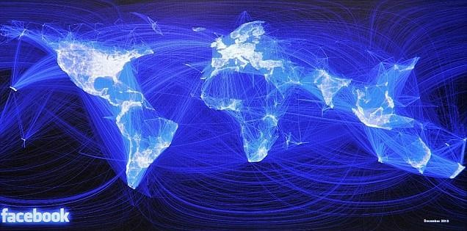
Facebook social graph
4-degrees of separation [Backstrom-Boldi-Rosa-Ugander-Vigna, 2011]
2

Slide 3
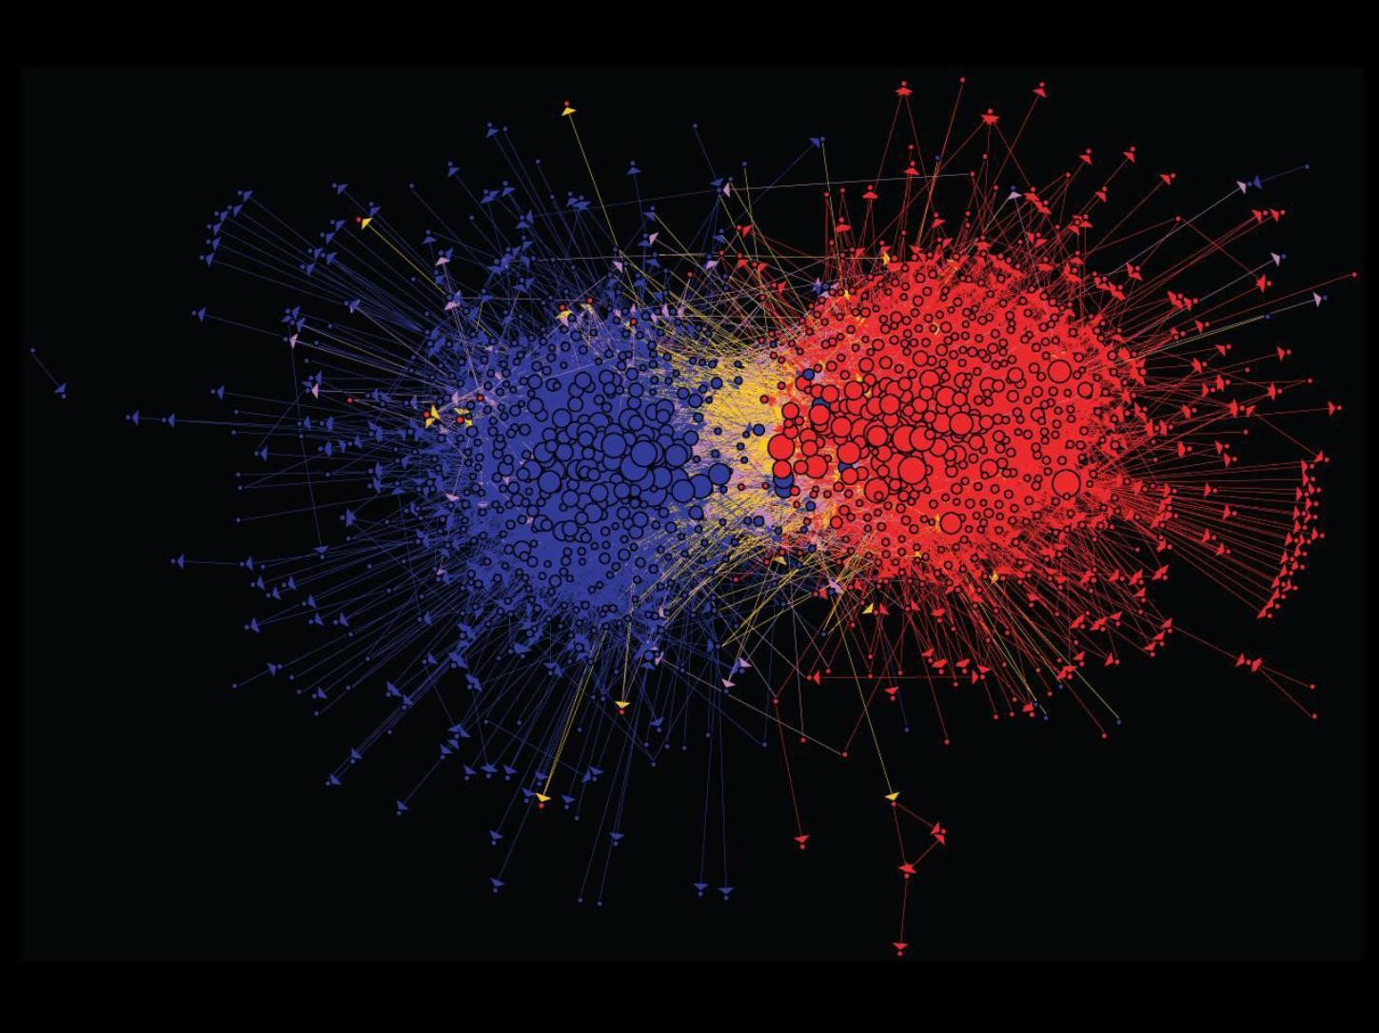
Connections between political blogs
Polarization of the network [Adamic-Glance, 2005]
3

Slide 4
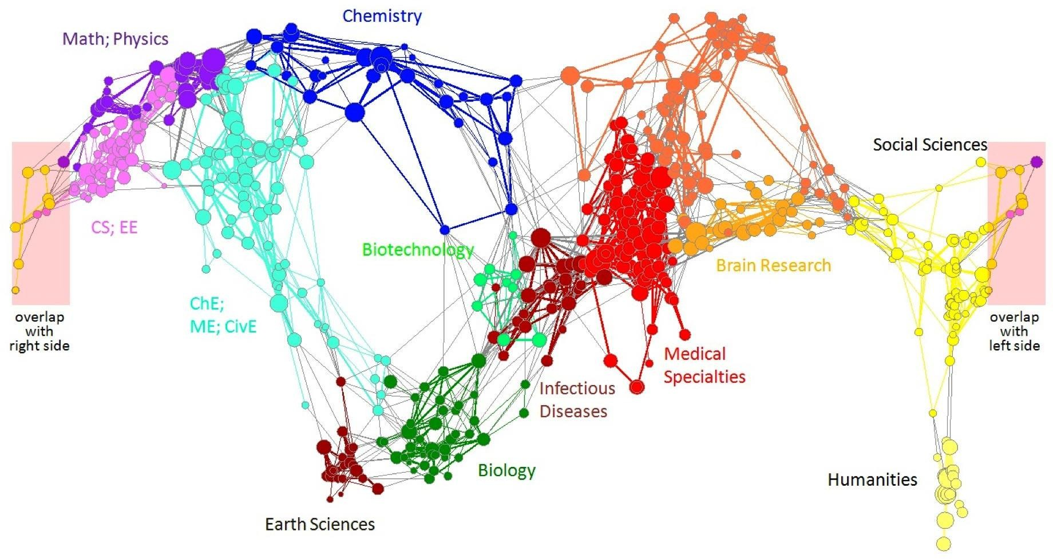
Citation networks and Maps of science
[Börner et al., 2012]
4

Slide 5
























domain2
domain1
router
domain3
Internet
5

Slide 6
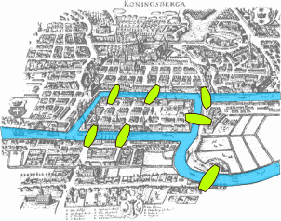
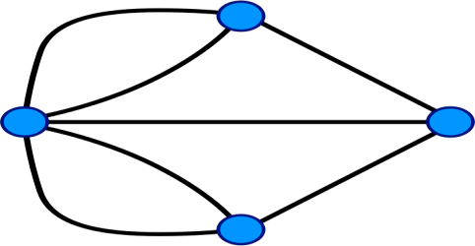
Seven Bridges of Königsberg
[Euler, 1735]
Return to the starting point by traveling each
link of the graph once and only once.
6

Slide 7









Web as a directed graph:
Nodes: Webpages
Edges: Hyperlinks
I teach a class on Networks.
CS224W:
Classes are in the Gates building
Computer Science Department at Stanford
Stanford University
7

Slide 8


Web as a directed graph:
Nodes: Webpages
Edges: Hyperlinks
I teach a class on Networks.
CS224W:
Classes are in the Gates building
Computer Science Department at Stanford
Stanford University
8

Slide 9
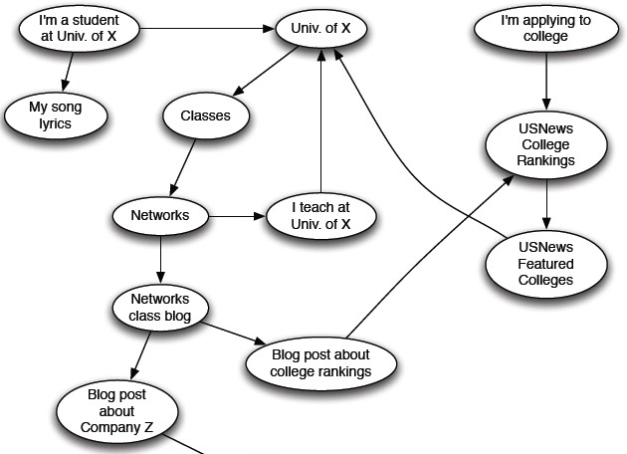
9

Slide 10



How to organize the Web?
First try: Human curated
Web directories
Yahoo, DMOZ, LookSmart
Second try: Web Search
Information Retrieval investigates:
Find relevant docs in a small and trusted set
Newspaper articles, Patents, etc.
But: Web is huge, full of untrusted documents, random things, web spam, etc.
10

Slide 11
2 challenges of web search:
(1) Web contains many sources of information
Who to “trust”?
Trick: Trustworthy pages may point to each other!
(2) What is the “best” answer to query “newspaper”?
No single right answer
Trick: Pages that actually know about newspapers might all be pointing to many newspapers
11

Slide 12

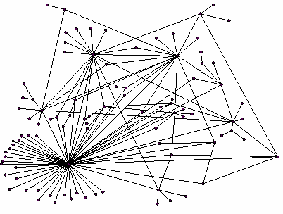

All web pages are not equally “important”
thispersondoesnotexist.com vs. www.stanford.edu
There is a large diversity in the web-graph
node connectivity.
Let’s rank the pages by
the link structure!
12

Slide 13
We will cover the following Link Analysis approaches for computing importance of nodes in a graph:
PageRank
Topic-Specific (Personalized) PageRank
Web Spam Detection Algorithms
13

Slide 14


Slide 15

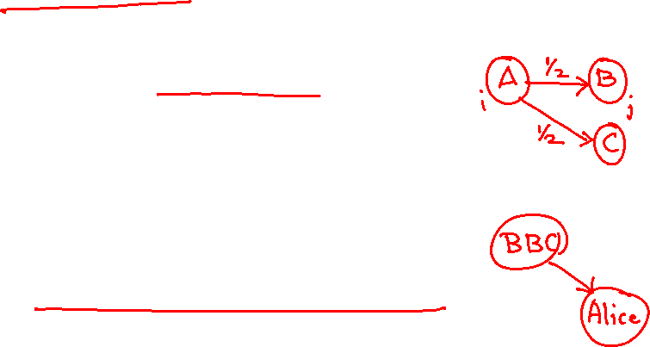
Idea: Links as votes
Page is more important if it has more links
In-coming links? Out-going links?
Think of in-links as votes:
www.stanford.edu has millions in-links
thispersondoesnotexist.com has a few thousands in-link
Are all in-links equal?
Links from important pages count more
Recursive question!
4/27/2021
Jure Leskovec, Stanford C246: Mining Massive Datasets
16

Slide 16

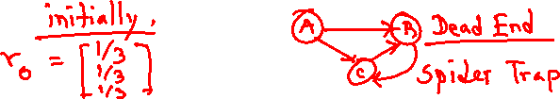
Web pages are important if people visit them a lot.
But we can’t watch everybody using the Web.
A good surrogate for visiting pages is to assume people follow links randomly.
Leads to random surfer model:
Start at a random page and follow random out- links repeatedly, from whatever page you are at.
PageRank = limiting probability of being at a page.

Slide 17

Solve the recursive equation: “importance of a page = its share of the importance of each of its predecessor pages”
Equivalent to the random-surfer definition of PageRank
Technically, importance = the principal eigenvector of the transition matrix of the Web
A few fix-ups needed

Slide 18
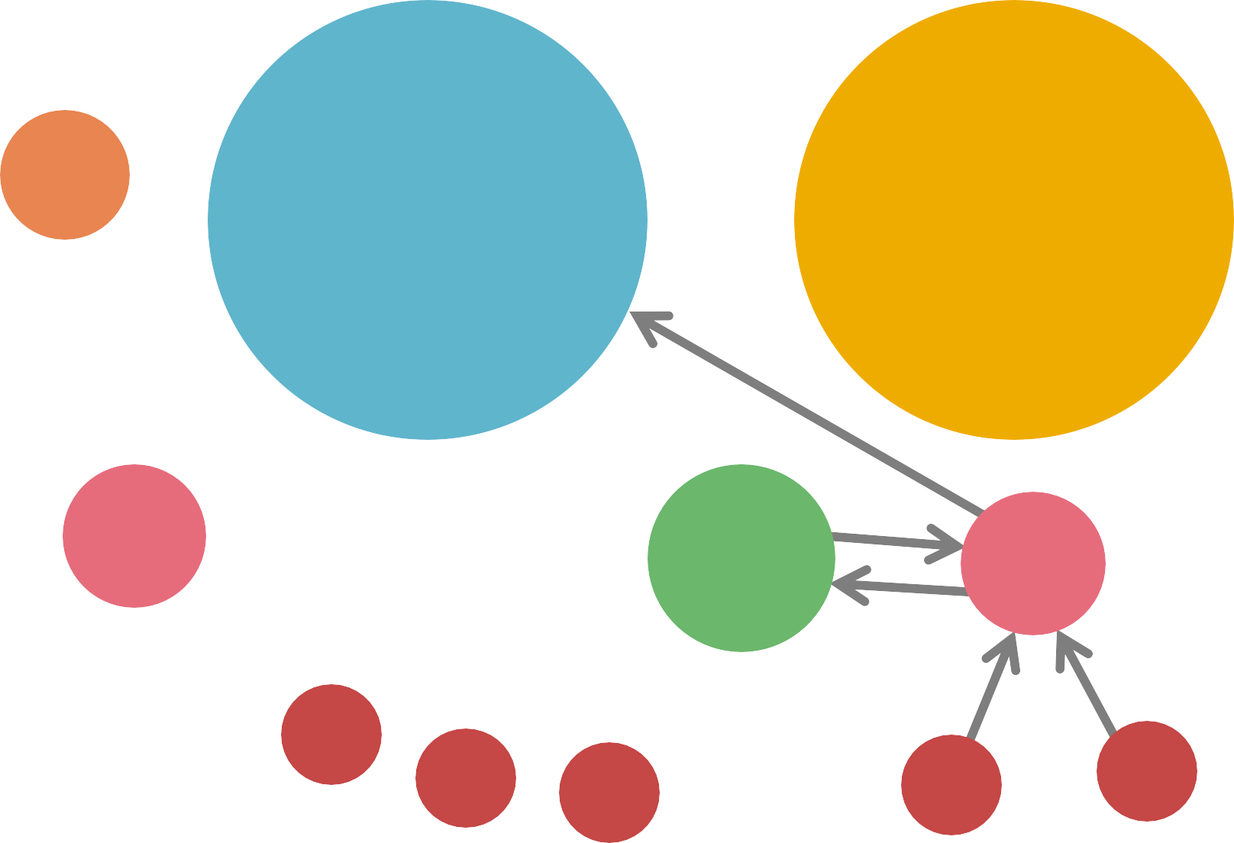

A 3.3
B 38.4
C 34.3
D 3.9
E
8.1
F 3.9
1.6
1.6
1.6
1.6
1.6

Slide 19

























Each link’s vote is proportional to the
importance of its source page
If page j with importance r_{j} has n out-links, each link gets r_{j} / n votes
Page j’s own importance is the sum of the
votes on its in-links
i
k
r_{k}/4
r_{j}/3 r_{j}/3
r_{i}/3
j
r_{j}/3
r_{j} = r_{i}/3+r_{k}/4

Slide 20




A “vote” from an important
page is worth more
A page is important if it is
pointed to by other important pages
Define a “rank” r_{j} for page j
The web in 1839
r_{y}/2
y
r /2
a
r /2
y
r_{m}
a
m
r
r_{a}/2
r_{j} = ∑
“Flow” equations:
r_{y} = r_{y} /2 + r_{a} /2 r_{a} = r_{y} /2 + r_{m}
r_{m} = r_{a} /2
𝒅_{𝒊} … out-degree of node 𝒊

Slide 21
3 equations, 3 unknowns, no constants
Flow equations:
r_{y} = r_{y} /2 + r_{a} /2
r_{a} = r_{y} /2 + r_{m} r_{m} = r_{a} /2
No unique solution
All solutions equivalent modulo the scale factor
Additional constraint forces uniqueness:
𝒓_{𝒚} + 𝒓_{𝒂} + 𝒓_{𝒎} = 𝟏
𝟐 𝟐
₌ 𝟏
Solution: 𝒓_{𝒚}
= , 𝒓_{𝒂}
𝟓
= , 𝒓_{𝒎}
𝟓 𝟓
Gaussian elimination method works for small examples, but we need a better method for large web-size graphs
We need a new formulation!

Slide 22

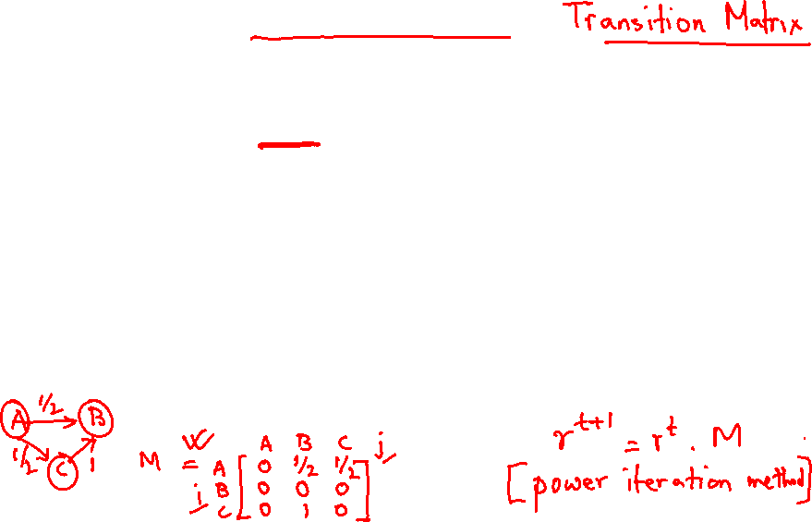
Stochastic adjacency matrix 𝑴
Let page 𝑖 has 𝑑_{𝑖} out-links
If , then else
𝑴 is a column stochastic matrix
Columns sum to 1
Rank vector 𝒓: vector with an entry per page
𝑟_{𝑖} is the importance score of page 𝑖
σ_{𝑖} 𝑟_{𝑖} = 1
The flow equations can be written
r
r_{j} = ∑

Slide 23


j ∑
i→ j
r
Remember the flow equation:
r =
i
d
Flow equation in the matrix form
𝑴 ⋅ 𝒓 = 𝒓
i
Suppose page i links to 3 pages, including j
i
j
r_{j}
.
=
r_{i}
1/3
M
.
r
=
r

Slide 24




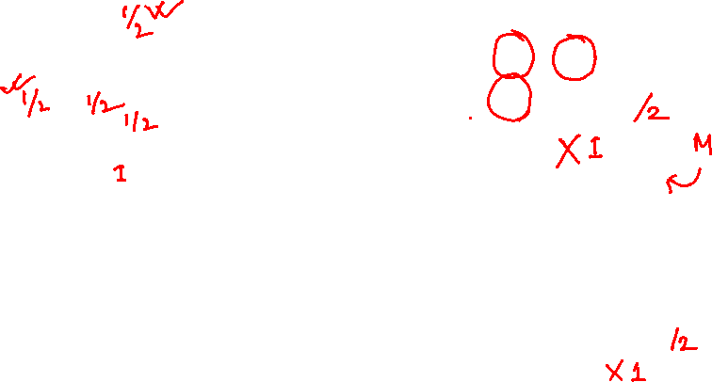
 | r_{y} | r_{a} | r_{m}
r_{y} | ½ | ½ | 0
r_{a} | ½ | 0 | 1
r_{m} | 0 | ½ | 0
y
a
m
r = M∙r
r_{y} = r_{y} /2 + r_{a} /2 r_{a} = r_{y} /2 + r_{m}
r_{y} r_{a} r_{m}
½ ½ 0
= ½ 0 1
0 ½ 0
r_{y} r_{a} r_{m}
r_{m} = r_{a} /2

Slide 25

The flow equations can be written
𝒓 = 𝑴 ∙ 𝒓
So the rank vector r is an eigenvector of the stochastic web matrix M
Starting from any stochastic vector 𝒖, the limit
𝑴(𝑴(… 𝑴(𝑴 𝒖)))
is the long-term distribution of the surfers.
NOTE: x is an eigenvector with
The math: limiting distribution = principal eigenvector of 𝑀 = PageRank.
Note: If 𝒓 is the limit of 𝑴𝑴 … 𝑴𝒖, then 𝒓 satisfies
the corresponding
eigenvalue λ if:
𝑨𝒙 = 𝝀𝒙
the equation 𝒓 = 𝑴𝒓, so r is an eigenvector of 𝑴 with eigenvalue 1
We can now efficiently solve for r! The method is called Power iteration

Slide 26

Given a web graph with N nodes, where the nodes are pages and edges are hyperlinks Power iteration: a simple iterative scheme
Suppose there are N web pages
_{r} (t )
_{= ∑} i
Initialize: r⁽⁰⁾ = [1/N,….,1/N]^{T}
Iterate: r^{(t+1)} = M ∙ r^{(t)}
Stop when |r^{(t+1)} – r^{(t)}|₁ < ε
(t +1)
r_{j}
d_{i}
i→ j
d_{i} …. out-degree of node i
|x|₁ = ∑_{1≤i≤N}|x_{i}| is the L1 norm
Can use any other vector norm, e.g., Euclidean
About 50 iterations is sufficient to estimate the limiting solution.

Slide 27



Power Iteration:
y
 | y | a | m
y | ½ | ½ | 0
a | ½ | 0 | 1
m | 0 | ½ | 0
Set 𝑟_{𝑗} = 1/N
a
m
1: 𝑟′ = σ
𝑟_{𝑖}
𝑗
2: 𝑟 = 𝑟′
Goto 1
Example:
𝑖→𝑗 _{𝑑𝑖}
r_{y} = r_{y} /2 + r_{a} /2 r_{a} = r_{y} /2 + r_{m} r_{m} = r_{a} /2
r_{y}
r_{a} =
r_{m}
1/3
1/3
1/3
1/3
3/6
1/6
5/12
1/3
3/12
9/24
11/24
1/6
6/15
… 6/15
3/15
Iteration 0, 1, 2, …

Slide 28
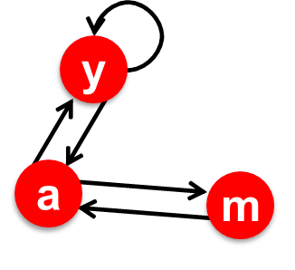
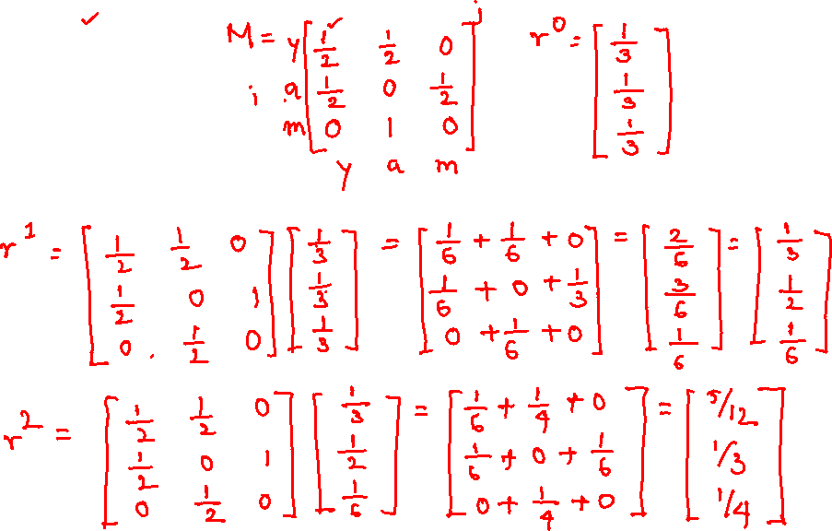

Slide 29
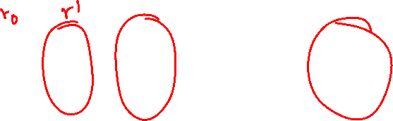
Power Iteration:
y
 | y | a | m
y | ½ | ½ | 0
a | ½ | 0 | 1
m | 0 | ½ | 0
Set 𝑟_{𝑗} = 1/N
a
m
1: 𝑟′ = σ
𝑟_{𝑖}
𝑗
2: 𝑟 = 𝑟′
Goto 1
Example:
𝑖→𝑗 _{𝑑𝑖}
r_{y} = r_{y} /2 + r_{a} /2 r_{a} = r_{y} /2 + r_{m} r_{m} = r_{a} /2
r_{y} |  | 1/3 | 1/3 | 5/12 | 9/24 |  | 6/15
r_{a} | = | 1/3 | 3/6 | 1/3 | 11/24 | … | 6/15
r_{m} |  | 1/3 | 1/6 | 3/12 | 1/6 |  | 3/15
Iteration 0, 1, 2, …
29

Slide 30

Imagine a random web surfer:
i₁ i₂ i₃
At any time 𝒕, surfer is on some page 𝒊
At time 𝒕 + 𝟏, the surfer follows an out-link from 𝒊 uniformly at random
Ends up on some page 𝒋 linked from 𝒊
Process repeats indefinitely
Let:
j
r = ∑
r
j
𝒑(𝒕) … vector whose 𝒊^{th} coordinate is the prob. that the surfer is at page 𝒊 at time 𝒕
So, 𝒑(𝒕) is a probability distribution over pages

Slide 31
Where is the surfer at time t+1?
i₁ i₂ i₃
Follows a link uniformly at random
𝒑 𝒕 + 𝟏 = 𝑴 ⋅ 𝒑(𝒕)
j
p(t +1) = M ⋅ p(t)
Suppose the random walk reaches a state
𝒑 𝒕 + 𝟏 = 𝑴 ⋅ 𝒑(𝒕) = 𝒑(𝒕)
then 𝒑(𝒕) is stationary distribution of a random walk
Our original rank vector 𝒓 satisfies 𝒓 = 𝑴 ⋅ 𝒓
So, 𝒓 is a stationary distribution for the random walk

Slide 32
A central result from the theory of random walks (a.k.a. Markov processes):
For graphs that satisfy certain conditions, the stationary distribution is unique and eventually will be reached no matter what is
the initial probability distribution at time t = 0

Slide 33

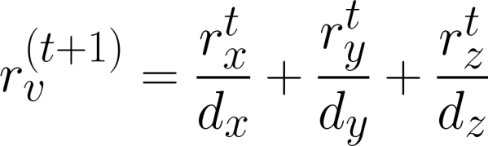
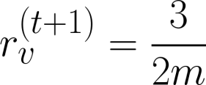
Given an undirected graph with N nodes, where the nodes are pages and edges are hyperlinks
Claim [Existence]: For node v, r_{v} = d_{v}/2m is a solution.
x
y
z
v
Proof:
Iteration step: r^{(t+1)} = M ∙ r^{(t)}
Substitute r_{i} = d_{i}/2m:
Done! Uniqueness: exercise! m = #edges

Slide 34

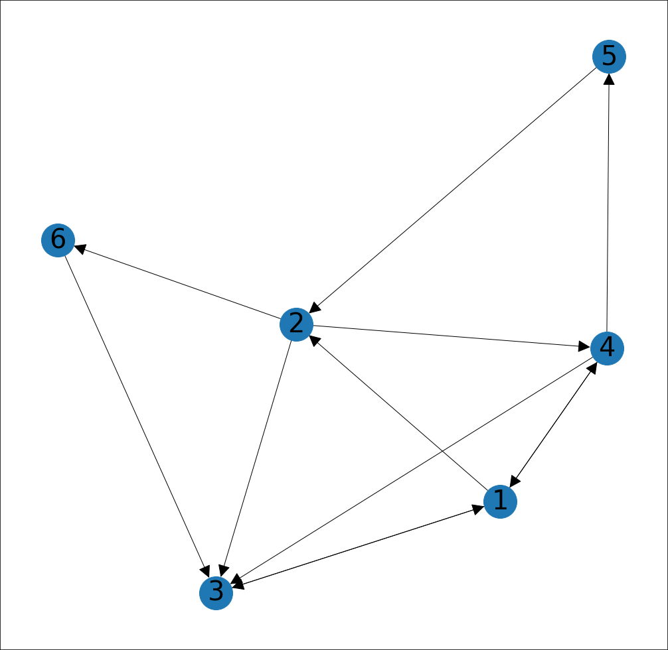
Which node has highest PageRank? Second highest?

Slide 35
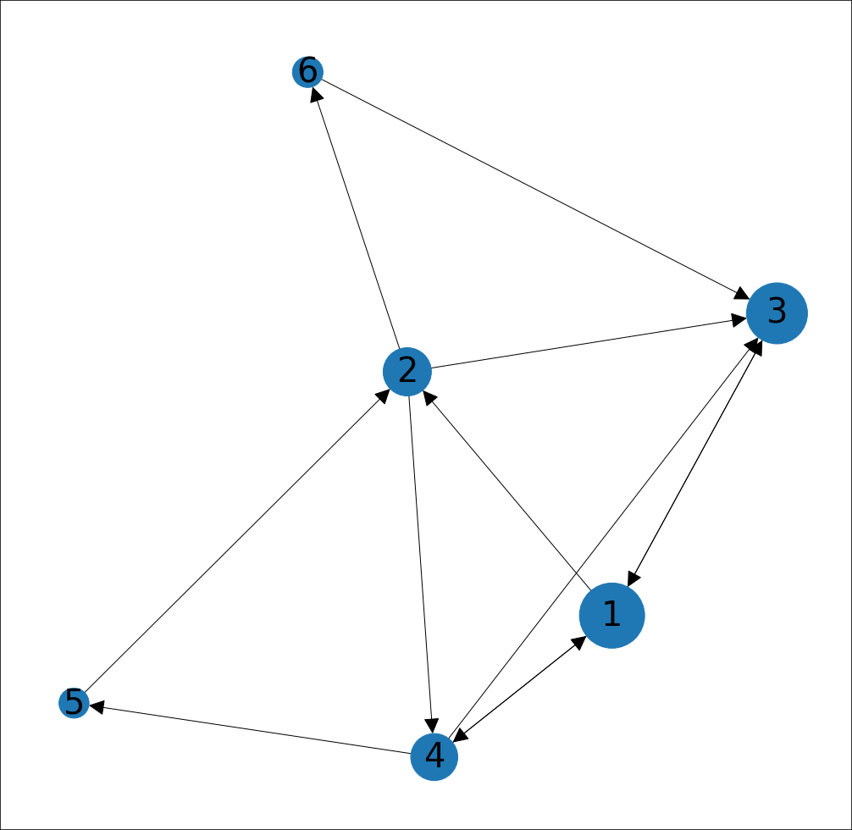
Node 1 has the highest PR, followed by Node 3 Degree ≠ PageRank

Slide 36
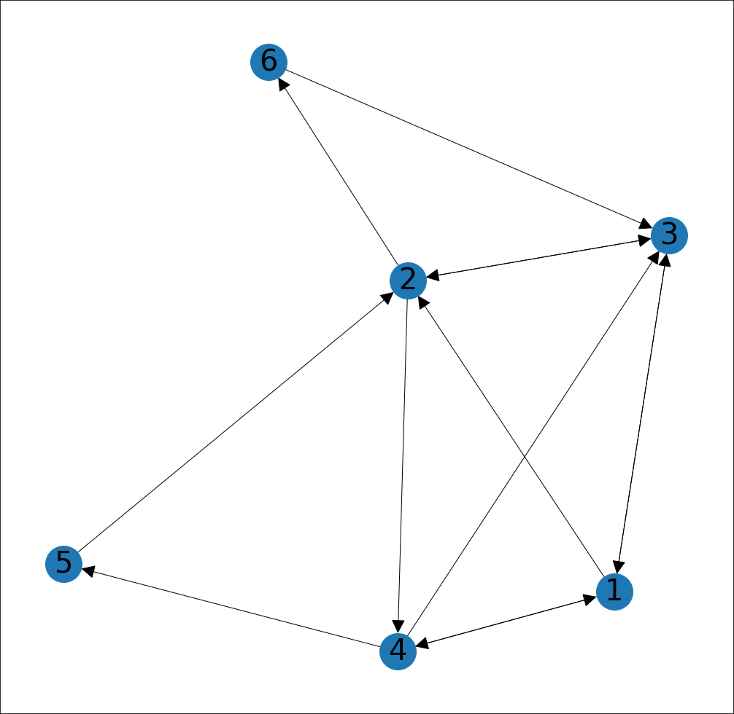
Add edge 3 -> 2. Now, which node has highest PageRank? Second highest?

Slide 37
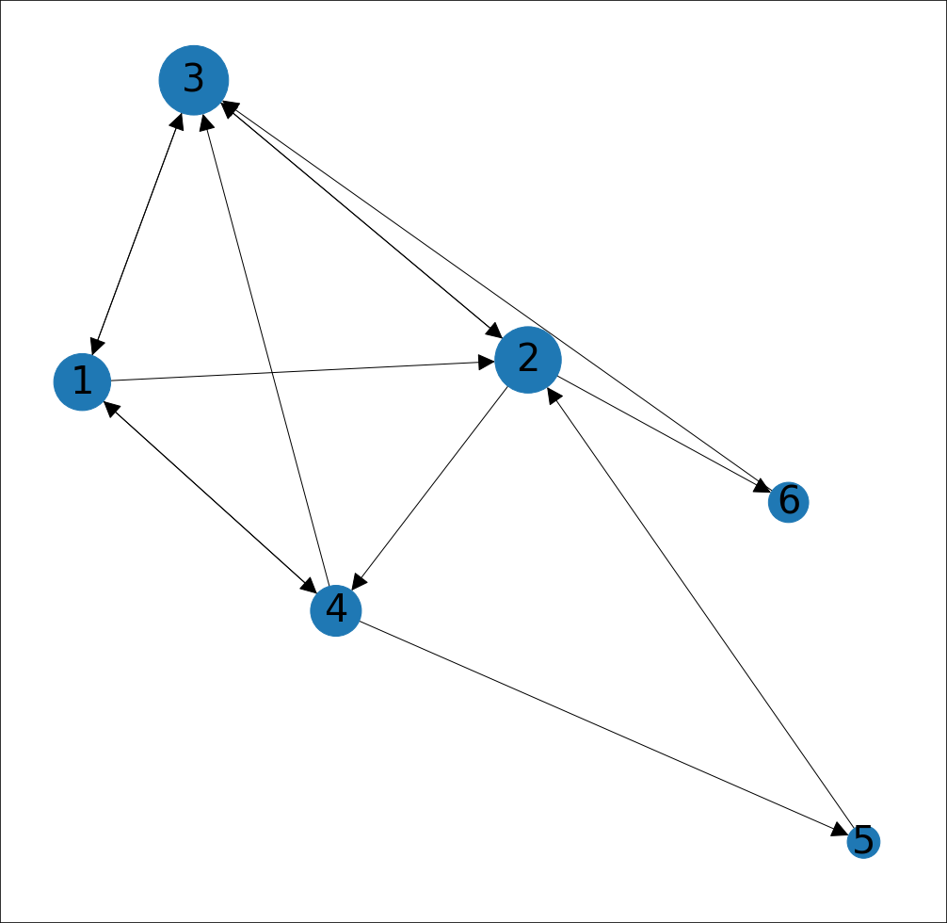
Node 3 has the highest PR, followed by 2. Small changes to graph can change PR!

Slide 38


Slide 39
∑
_{r} (t )
(t +1)
r_{j} =
i
r = Mr
or equivalently
d
i→ j
i
Does this converge?
Does it converge to what we want? Are results reasonable?

Slide 40





_{r} (t )
_{= ∑} i
a
b
r_{j}
(t +1)
d_{i}
i→ j
Example:
r_{a}
1 0 1 0
0 1 0 1
=
r_{b}
Iteration 0, 1, 2, …

Slide 41
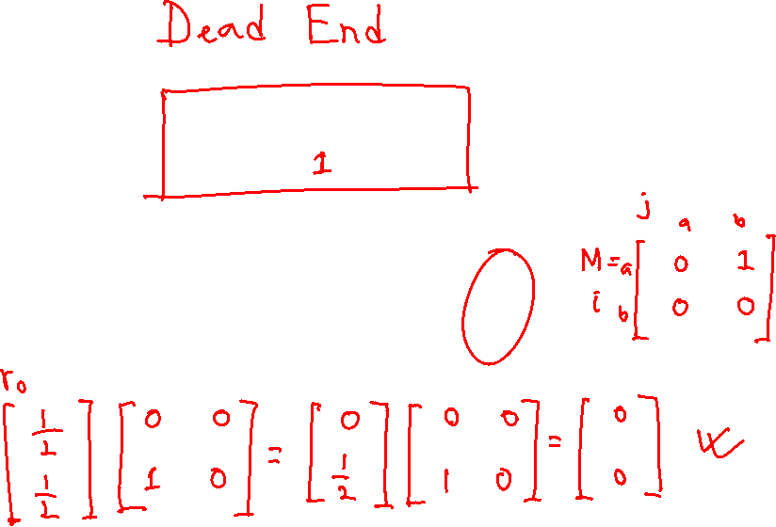
_{r} (t )
_{= ∑} i
a
b
r_{j}
(t +1)
d_{i}
i→ j
Example:
r_{a}
1 0 0 0
0 1 0 0
=
r_{b}
Iteration 0, 1, 2, …

Slide 42

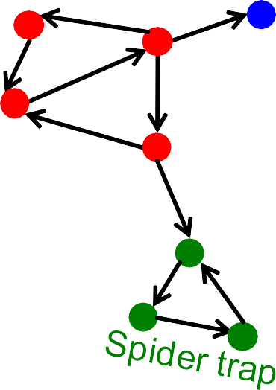
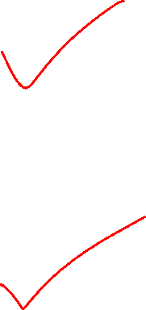
Two problems:
Dead end
(1) Dead ends: Some pages have no out-links
Random walk has “nowhere” to go to
Such pages cause importance to “leak out”
(2) Spider traps:
(all out-links are within the group)
Random walk gets “stuck” in a trap
And eventually spider traps absorb all importance

Slide 43

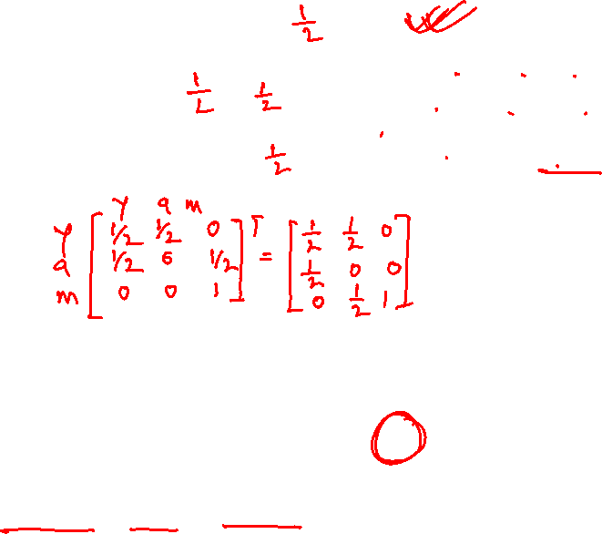
Power Iteration:
y
 | y | a | m
y | ½ | ½ | 0
a | ½ | 0 | 0
m | 0 | ½ | 1
Set 𝑟_{𝑗} = 1/𝑁
a
m
𝑟 = σ
𝑟_{𝑖}
𝑗 𝑖→𝑗 _{𝑑𝑖}
m is a spider trap
r_{y} = r_{y} /2 + r_{a} /2
r_{a} = r_{y} /2
r_{m} = r_{a} /2 + r_{m}
And iterate
Example:
r_{y} |  | 1/3 | 2/6 | 3/12 | 5/24 |  | 0
r_{a} | = | 1/3 | 1/6 | 2/12 | 3/24 | … | 0
r_{m} |  | 1/3 | 3/6 | 7/12 | 16/24 |  | 1
Iteration 0, 1, 2, …
All the PageRank score gets “trapped” in node m.

Slide 44



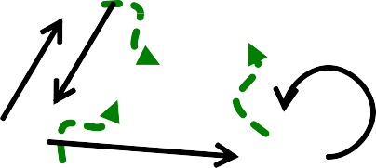




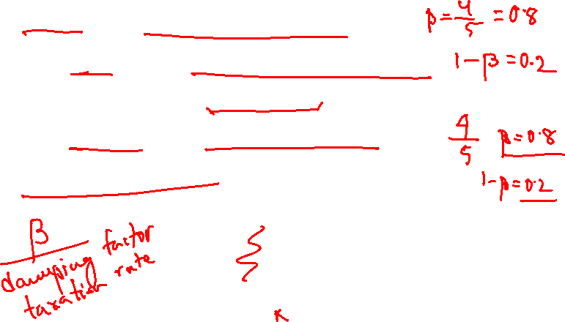
The Google solution for spider traps: At each time step, the random surfer has two options
With prob. β, follow a link at random
With prob. 1-β, jump to some random page
β is typically in the range 0.8 to 0.9 Surfer will teleport out of spider trap within a few time steps
y y
a a
m m

Slide 45
Power Iteration:
y
 | y | a | m
y | ½ | ½ | 0
a | ½ | 0 | 0
m | 0 | ½ | 0
Set 𝑟_{𝑗} = 1/𝑁
a
m
𝑟 = σ
𝑟_{𝑖}
𝑗 𝑖→𝑗 _{𝑑𝑖}
r_{y} = r_{y} /2 + r_{a} /2
r_{a} = r_{y} /2
r_{m} = r_{a} /2
And iterate
Example:
r_{y} |  | 1/3 | 2/6 | 3/12 | 5/24 |  | 0
r_{a} | = | 1/3 | 1/6 | 2/12 | 3/24 | … | 0
r_{m} |  | 1/3 | 1/6 | 1/12 | 2/24 |  | 0
Iteration 0, 1, 2, …
Here the PageRank score “leaks” out since the matrix is not stochastic.

Slide 46



Teleports: Follow random teleport links with probability 1.0 from dead-ends
Adjust matrix accordingly
y
y
a
m
a
m
 | y | a | m
y | ½ | ½ | 0
a | ½ | 0 | 0
m | 0 | ½ | 0
 | y | a | m
y | ½ | ½ | ⅓
a | ½ | 0 | ⅓
m | 0 | ½ | ⅓

Slide 47
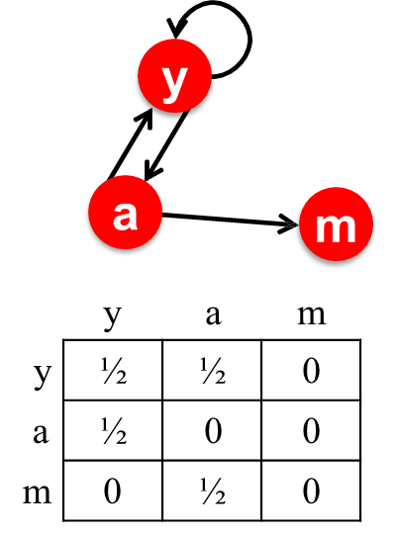

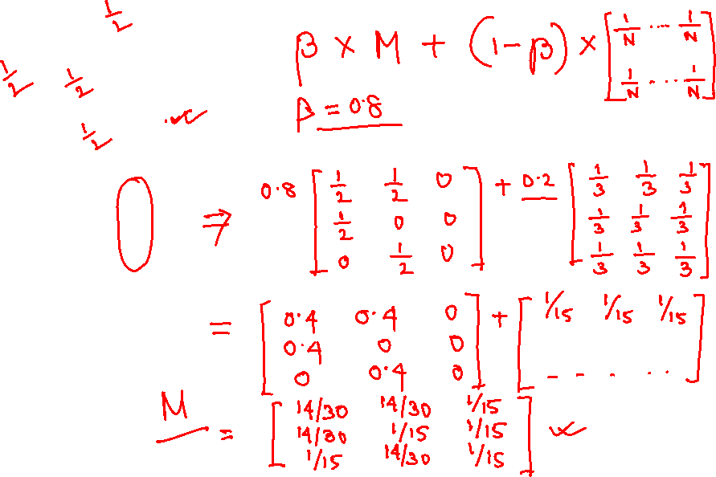

Slide 48
Why are dead-ends and spider traps a problem and why do teleports solve the problem?
Spider-traps are not a problem, but with traps PageRank scores are not what we want
Solution: Never get stuck in a spider trap by teleporting out of it in a finite number of steps
Dead-ends are a problem
The matrix is not column stochastic so our initial assumptions are not met
Solution: Make matrix column stochastic by always teleporting when there is nowhere else to go

Slide 49


Google’s solution that does it all:
At each step, random surfer has two options:
With probability β, follow a link at random
With probability 1-β, jump to some random page
PageRank equation [Brin-Page, 98]
d_{i} … out-degree
of node i
This formulation assumes that 𝑴 has no dead ends. We can either preprocess matrix 𝑴 to remove all dead ends or explicitly follow random teleport links with probability 1.0 from dead-ends.

Slide 50





The Google Matrix A:
PageRank equation [Brin-Page, ‘98]
[1/N]_{NxN}…N by N matrix where all entries are 1/N
We have a recursive problem: 𝒓 = 𝑨 ⋅ 𝒓
And the Power method still works! What is β ?
In practice β =0.8,0.9 (jump every 5 steps on avg.)

Slide 51
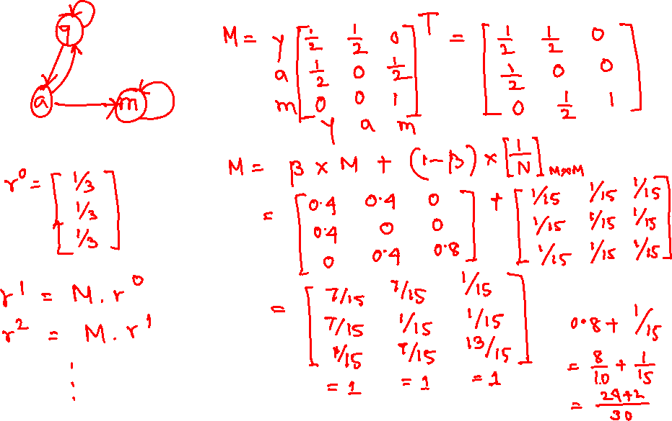

Slide 52


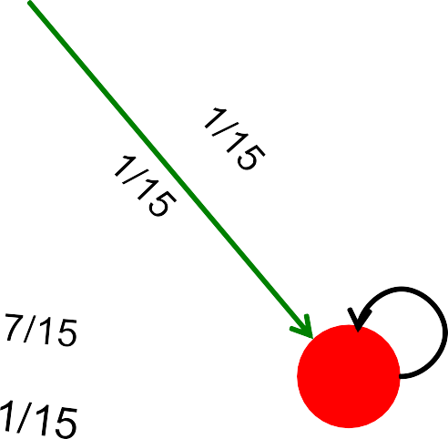


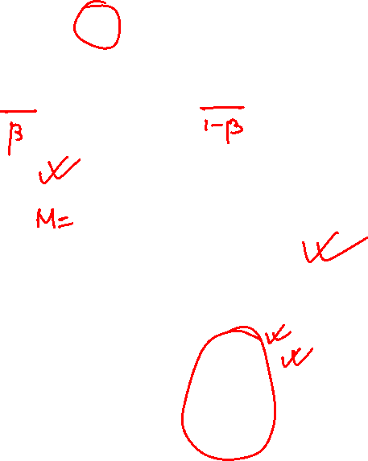
M
[1/N]_{NxN}
7/15
 |  | 1/2 1/2 | 0 |  | 1/3 1/3 1/3
 | 0.8 | 1/2 0 | 0 | + 0.2 | 1/3 1/3 1/3
 |  | 0 1/2 | 1 |  | 1/3 1/3 1/3
y
y a m
7/15 7/15 1/15
7/15 1/15 1/15
1/15 7/15 13/15
13/15
a
m
A
y
a =
m
1/3 | 0.33 | 0.24 | 0.26 7/33
1/3 | 0.20 | 0.20 | 0.18 . . . 5/33
1/3 | 0.46 | 0.52 | 0.56 21/33

Slide 53


Slide 54


Key step is matrix-vector multiplication
_{r}new _{= A ∙ r}old
Easy if we have enough main memory to hold A, r^{old}, r^{new}
Say N = 1 billion pages
We need 4 bytes for each entry (say)
2 billion entries for vectors, approx 8GB
Matrix A has N² entries
10¹⁸ is a large number!
A = β∙M + (1-β) [1/N]_{NxN}
½ ½ 0
½ 0 0
0 ½ 1
1/3 1/3 1/3
1/3 1/3 1/3
1/3 1/3 1/3
A = 0.8
+0.2
7/15 | 7/15 | 1/15
7/15 | 1/15 | 1/15
1/15 | 7/15 | 13/15
=

Slide 55











, where
_{= σ}𝑁
𝑟_{𝑗}
𝐴_{𝑗𝑖} ⋅ 𝑟_{𝑖}
i=1
since
So we get:
Note: Here we assume M
has no dead-ends
[x] … a vector of length N with all entries x
N

Slide 56
We just rearranged the PageRank equation
where [(1-β)/N]_{N} is a vector with all N entries (1-β)/N
M is a sparse matrix! (with no dead-ends)
10 links per node, approx 10𝑁 entries
So in each iteration, we need to:
Compute r^{new} = β M ∙ r^{old}
Add a constant value (1-β)/N to each entry in r^{new}
Note if M contains dead-ends then σ 𝒓^{𝒏𝒆𝒘} < 𝟏 and
𝒋 𝒋
we also have to renormalize r^{new} so that it sums to 1

Slide 57
Input: Graph 𝑮 and parameter 𝜷
Directed graph 𝑮 (can have spider traps and dead ends)
Parameter 𝜷
Output: PageRank vector 𝒓^{𝒏𝒆𝒘}
₌ 1
Set: 𝑟^{𝑜𝑙𝑑}
𝑗
𝑁
repeat until convergence: σ_{𝑗} 𝑟^{𝑛𝑒𝑤} − 𝑟^{𝑜𝑙𝑑}
< 𝜀
𝑗 𝑗
_{𝒓}𝒐𝒍𝒅
𝒏𝒆𝒘
∀𝑗: 𝒓′_{𝒋} = σ
𝒊→𝒋 ^{𝜷}
𝒊
𝒅_{𝒊}
𝒓′^{𝒏𝒆𝒘} = 𝟎 if in-degree of 𝒋 is 0
𝒋
Now re-insert the leaked PageRank:
∀𝒋: 𝒓^{𝒏𝒆𝒘} = 𝒓^{′𝒏𝒆𝒘} + ^{𝟏−𝑺}
where: 𝑆 = σ 𝑟′^{𝑛𝑒𝑤}
𝒋
_{𝒓}𝒐𝒍𝒅 _{= 𝒓}𝒏𝒆𝒘
𝒋
𝑵
𝑗 𝑗
If the graph has no dead-ends then the amount of leaked PageRank is 1-β. But since we have dead-ends the amount of leaked PageRank may be larger. We have to explicitly account for it by computing S.

Slide 58

Encode sparse matrix using only nonzero entries
Space proportional roughly to number of links
Say 10N, or 4*10*1 billion = 40GB
Still won’t fit in memory, but will fit on disk
source
node
degree destination nodes
0 | 3 | 1, 5, 7
1 | 5 | 17, 64, 113, 117, 245
2 | 2 | 13, 23

Slide 59
Assume enough RAM to fit r^{new} into memory
Store r^{old} and matrix M on disk
1 step of power-iteration is:
Initialize all entries of r^{new} = (1-β) / N
For each page i (of out-degree d_{i}):
Read into memory: i, d_{i}, dest₁, …, dest_{di}, r^{old}(i)
For j = 1…d_{i}
r^{new}(dest_{j}) += β r^{old}(i) / d_{i}
Assuming no dead ends
0
1
2
3
4
5
6
4/27/2021
r^{new} source degree destination r^{old}
0
1
2
3
4
5
6
0 | 3 | 1, 5, 6
1 | 4 | 17, 64, 113, 117
2 | 2 | 13, 23
Jure Leskovec, Stanford C246: Mining Massive Datasets
60

Slide 60

Assume enough RAM to fit r^{new} into memory
Store r^{old} and matrix M on disk
In each iteration, we have to:
Read r^{old} and M
Write r^{new} back to disk
Cost per iteration of Power method:
= 2|𝒓| + |𝑴|
Question:
What if we could not even fit r^{new} in memory?

Slide 61
_{r}new
src degree
destination
_{r}old
0
1
0 | 4 | 0, 1, 3, 5
1 | 2 | 0, 5
2 | 2 | 3, 4
0
1
2
3
4
5
2
3
M
4
5
Break r^{new} into k blocks that fit in memory
Scan M and r^{old} once for each block

Slide 62
Similar to nested-loop join in databases
Break r^{new} into k blocks that fit in memory
Scan M and r^{old} once for each block
Total cost:
k scans of M and r^{old}
Cost per iteration of Power method:
𝑘(|𝑴| + |𝒓|) + |𝒓| = 𝒌|𝑴| + (𝒌 + 𝟏)|𝒓|
Can we do better?
Hint: M is much bigger than r (approx 10-20x), so we must avoid reading it k times per iteration

Slide 63
destination
src degree
_{r}new
0
1
0 | 4 | 0, 1
1 | 2 | 0
_{r}old
0
1
2
3
4
5
2
3
0 | 4 | 3
2 | 2 | 3
0 | 4 | 5
1 | 2 | 5
2 | 2 | 4
4
5
Break M into stripes! Each stripe contains only destination nodes in the corresponding block of r^{new}

Slide 64

Break M into stripes
Each stripe contains only destination nodes in the corresponding block of r^{new}
Some additional overhead per stripe
But it is usually worth it
Cost per iteration of Power method:
=|𝑴|(𝟏 + ε) + (𝒌 + 𝟏)|𝒓|
where 𝜀 is a small number.

Slide 65
Measures generic popularity of a page
Biased against topic-specific authorities
Solution: Topic-Specific PageRank (next)
Uses a single measure of importance
Other models of importance
Solution: Hubs-and-Authorities
Susceptible to Link spam
Artificial link topographies created in order to boost page rank
Solution: TrustRank

Slide 66
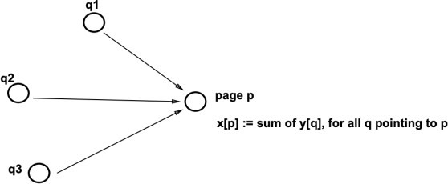

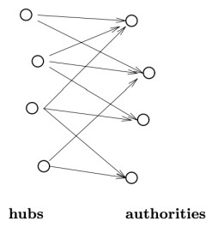
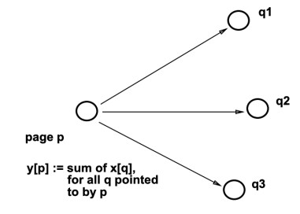
Classic work: Markov chains, citation analysis RankDex patent [Robin Li, '96]
Key idea: use backlinks (led to Baidu!)
HITS Algorithm [Kleinberg, SODA '98]
Key idea: iterative scoring!
PageRank work [Page et al, '98]

